Slide 1

DESIGN AND ANALYSIS OF ALGORITHMS
A
B
Travelling
Salesman
Problem
Link to B (3), C (4) and D (2); connects to next.
Link to A (3), C (5) and D (6); continues cycle.
C
D
Link to A (4), B (5) and D (1); leads toward finish.
Link to A (2), B (6) and C (1); completes highlighted cycle.
Finding the Optimal Route Using Algorithms
Student: ____________________ · Department: ____________________
College: ____________________ · Academic Year: ____________________
A route is easy to draw. Finding the best one is the problem.
01 · DAA / TSP

Slide 2
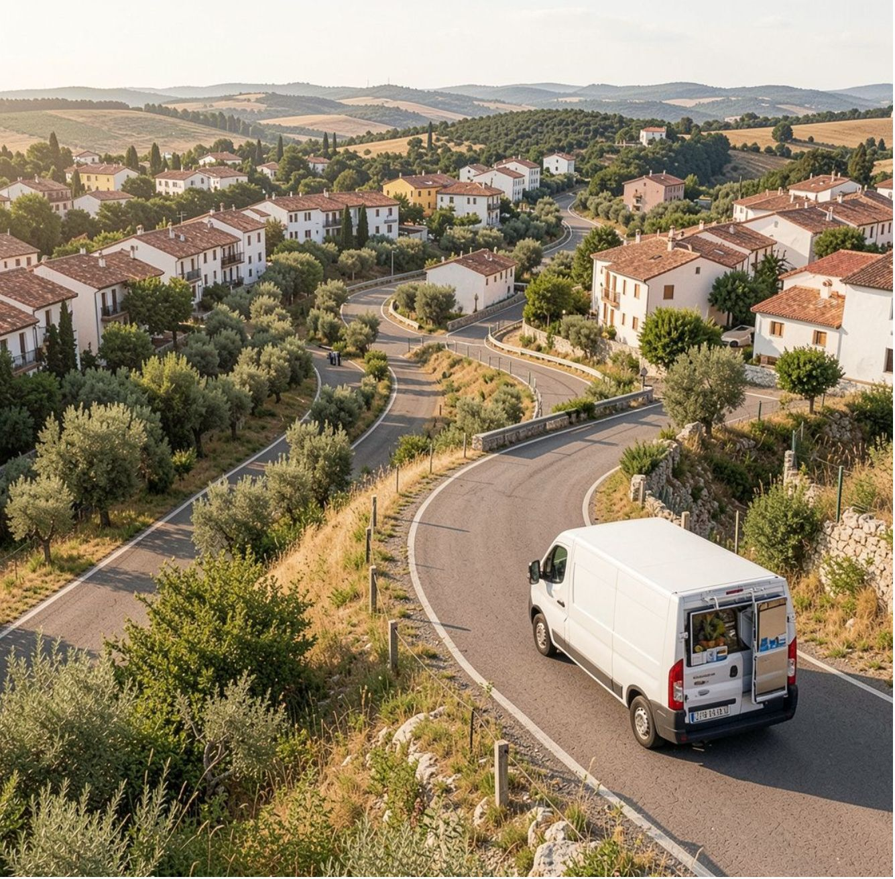
THE PROBLEM
Every city once—then back home
A simple rule creates a difficult search space.
01
02
03
Visit every city
Return to start
Minimize cost
Each city is visited exactly once.
The route closes into a complete tour.
Choose the tour with the least distance or travel cost.
As the number of cities increases, the possible routes grow rapidly.
One candidate tour, highlighted among many possible journeys.
02 · DAA / TSP

Slide 3
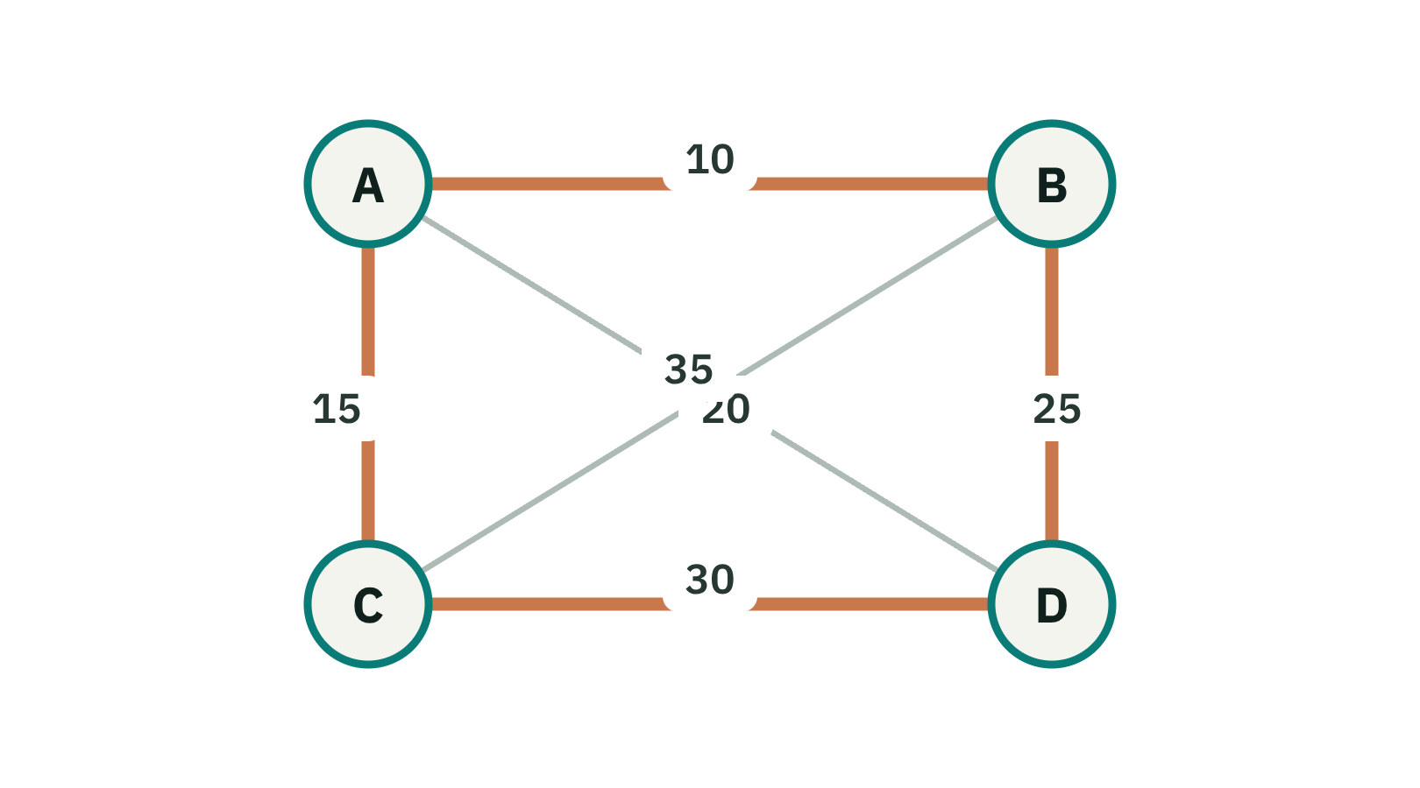
FORMAL MODEL
TSP turns a route into an optimization problem
Cities are vertices; travel links are weighted edges.
A tour visits each city exactly once and returns to the start.
Objective: minimize the total tour cost.
Over a Hamiltonian cycle; each d(i,j) is a distance or travel cost.
03 · DAA / TSP

Slide 4






VARIANTS AND APPLICATIONS
Two variants, many real-world uses
VARIANTS
APPLICATIONS
Symmetric TSP
Asymmetric TSP
Delivery and logistics
Vehicle routing and transportation
d(A,B) = d(B,A)
Travel cost is the same in either direction.
d(A,B) may differ from d(B,A)
Direction matters because of traffic, roads, or one-way constraints.
PCB drilling and manufacturing
Robotics and path planning
04 · DAA / TSP

Slide 5
EXACT SEARCH
Brute force guarantees the answer—at factorial cost
PSEUDOCODE
bestCost ← ∞
for each permutation p of cities:
cost ← tourCost(p)
if cost < bestCost:
bestCost ← cost
bestTour ← p
return bestTour, bestCost
01
02
03
Generate
Evaluate
Select
Every possible city permutation.
Calculate each tour's total cost.
Keep the minimum-cost tour.
Simple, complete, and increasingly expensive.
Time complexity: O(n!). It is exact, but quickly becomes impractical as n grows.
05 · DAA / TSP

Slide 6


DYNAMIC PROGRAMMING
Held–Karp reuses solutions to smaller subsets
{A}
{A,B}
{A,C}
State: DP[S][j] is the minimum cost to start at A, visit every city in subset S, and finish at j.
{A,B,C}
Time
O(n² × 2ⁿ)
Space
O(n × 2ⁿ)
Bitmasking represents each subset S compactly.
06 · DAA / TSP

Slide 7
SEARCH WITH PRUNING
Branch and bound prunes routes that cannot win
Branch-and-Bound
Route optimization search tree overview
Avoid exploring branches whose lower bound is already too high.
Explored
Calculate an initial lower bound; explore a promising partial route.
Compare its lower bound with the best known tour.
Prune branches whose bound cannot improve the current best.
bound 42
Promising
best 80
Pruned
prune
Practical performance depends on the bounding strategy and the instance; worst-case behavior remains exponential or factorial depending on formulation.
07 · DAA / TSP

Slide 8
WORKED EXAMPLE
CANDIDATE OPTIMAL ROUTE
Worked example: the best tour costs 80
A → B → D → C → A
Route leg | Weight
A → B | 10
B → D | 25
D → C | 30
C → A | 15
Symmetric distances: A–B 10, A–C 15, A–D 20, B–C 35, B–D 25, C–D 30.
A | B | C | D
0 | 10 | 15 | 20
10 | 0 | 35 | 25
15 | 35 | 0 | 30
20 | 25 | 30 | 0
80
Optimal tour cost
Distance matrix: A [0,10,15,20] · B [10,0,35,25] · C [15,35,0,30] · D [20,25,30,0].
10 + 25 + 30 + 15 = 80
08 · DAA / TSP

Slide 9
CHOOSING AN APPROACH
Algorithm choice is a trade-off
Algorithm | Basic technique | Complexity characteristics | Optimal? | Practical limitation
Brute Force | Enumerate all tours | O(n!) | Yes | Only small n
Held–Karp | Subset DP + bitmasking | O(n² × 2ⁿ) time; O(n × 2ⁿ) space | Yes | Memory-heavy for larger n
Branch and Bound | Search with lower bounds | Exponential or factorial worst case; instance-dependent | Yes when fully explored | Quality of bounds drives pruning
09 · DAA / TSP

Slide 10



TAKEAWAY
Brute force
Simple and exact, but expensive.
TSP connects
theory to
practical optimization.
Dynamic programming
Avoids repeated computation across subsets.
Branch and bound
Strong bounds can eliminate unnecessary search.
Central design question: how much computational cost can we spend for an optimal route?
The route is concrete. The search strategy determines what we can afford to solve.
References: Thomas H. Cormen et al., Introduction to Algorithms; Jon Kleinberg and Éva Tardos, Algorithm Design; MIT OpenCourseWare, algorithms and combinatorial optimization materials.
Thank You
10 · DAA / TSP
Generated by AI

